Slide 1

Energy Storage For Mechatronic Energy
Harvesting System
Nikolaos Chrysogelos

Slide 2
Storage Unit Optimization
Inductor Selection
Hardware Implementation
Control Scheme
Experimental results
Conclusions and Outlook

Slide 3
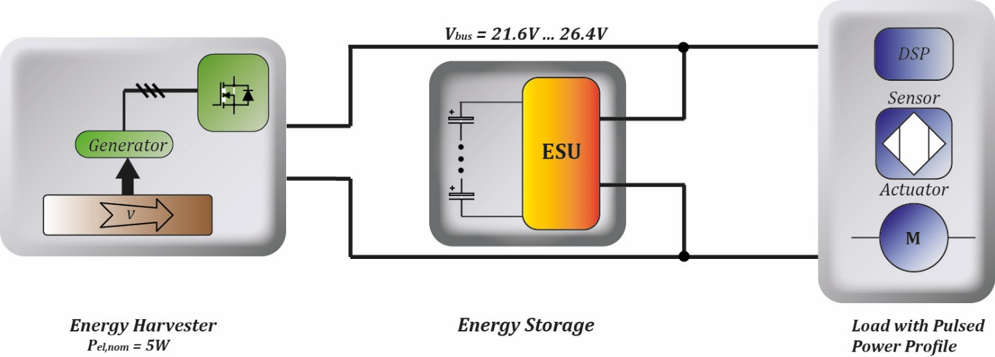
Overview of the System

Slide 4
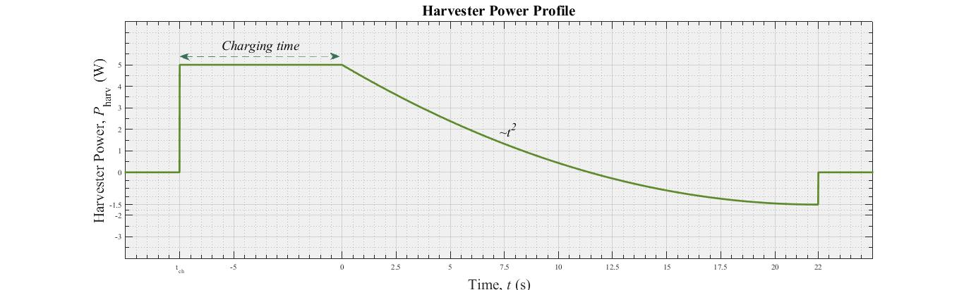
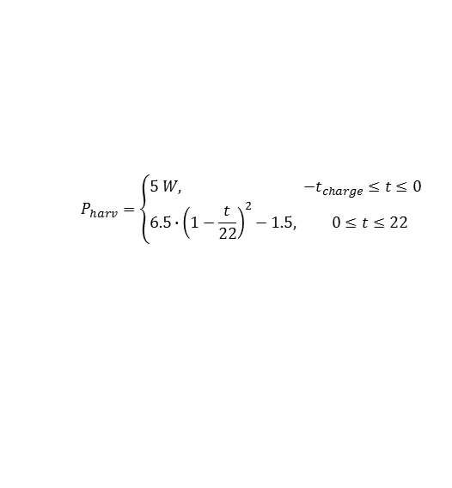
Overview of the System
Harvester
$$P_{harv}=\left\{\begin{aligned}&5 W, −t_{charge}≤t≤0 \\ &6.5∙{\left(1−\frac{t}{22}\right)}^{2}−1.5, 0≤t≤22\end{aligned}\right.$$

Slide 5
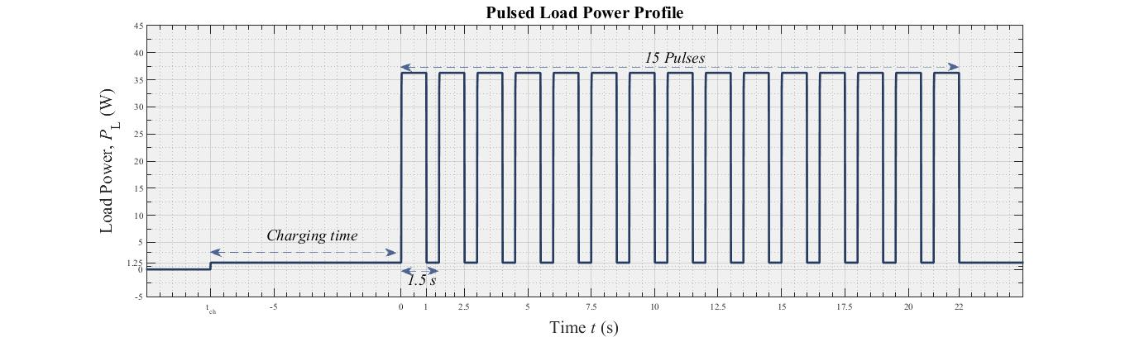
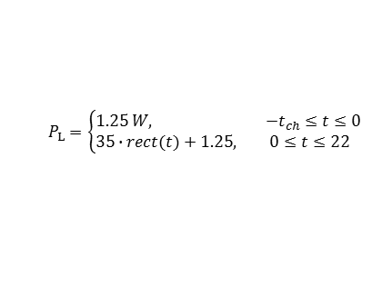
Overview of the System
Harvester
Pulsed Load
$$P_{harv}=\left\{\begin{aligned}&5 W, −t_{charge}≤t≤0 \\ &6.5∙{\left(1−\frac{t}{22}\right)}^{2}−1.5, 0≤t≤22\end{aligned}\right.$$
$$P_{L}=\left\{\begin{aligned}&1.25 W, −t_{ch}≤t≤0 \\ &35∙rect(t)+1.25, 0≤t≤22\end{aligned}\right.$$

Slide 6
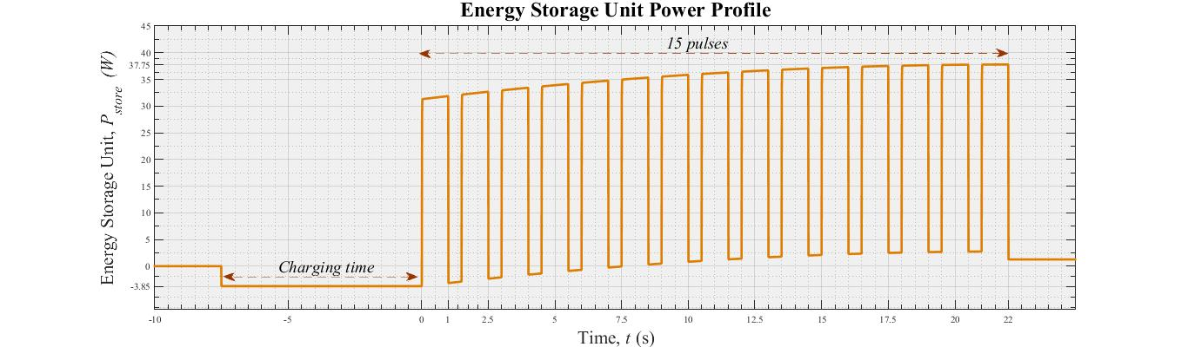
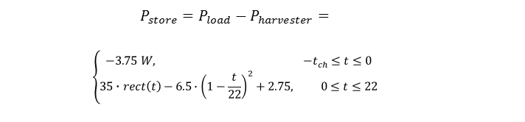
Overview of the System
Energy Storage Unit
$$P_{store}=P_{load}−P_{harvester}=$$
$$\left\{\begin{aligned}−3.75 W, −t_{ch}≤t≤0 \\ 35∙rect\left(t\right)−6.5∙{\left(1−\frac{t}{22}\right)}^{2}+2.75, 0≤t≤22\end{aligned}\right.$$
Harvester
Pulsed Load
$$P_{harv}=\left\{\begin{aligned}&5 W, −t_{charge}≤t≤0 \\ &6.5∙{\left(1−\frac{t}{22}\right)}^{2}−1.5, 0≤t≤22\end{aligned}\right.$$
$$P_{L}=\left\{\begin{aligned}&1.25 W, −t_{ch}≤t≤0 \\ &35∙rect(t)+1.25, 0≤t≤22\end{aligned}\right.$$

Slide 7
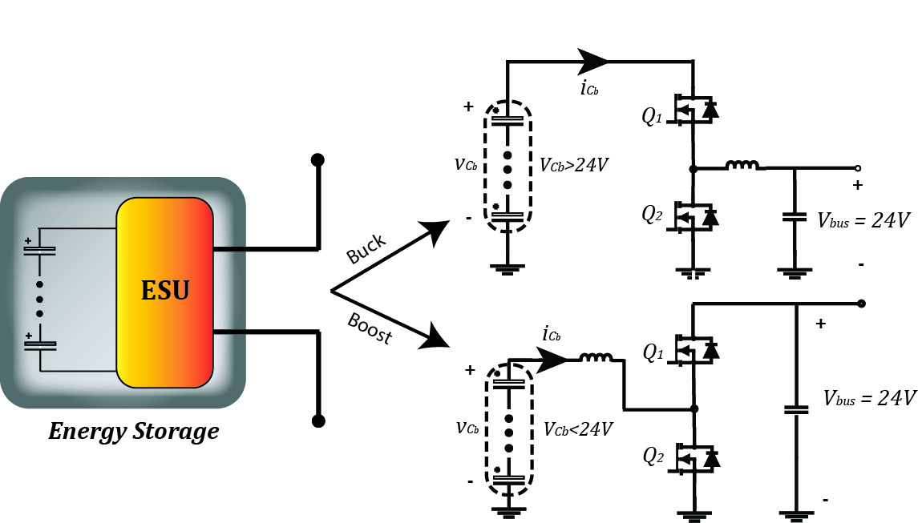
Topology of the Storage System

Slide 8
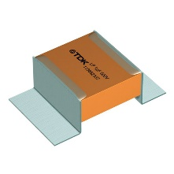
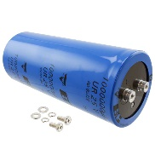
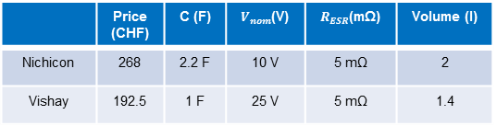
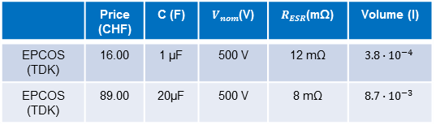
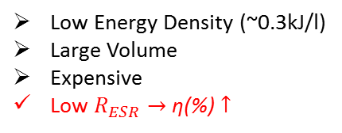
Topology of the Storage System
Ceralink & ELCO
Low Energy Density (~0.3kJ/l)
Large Volume
Expensive
Low $R_{ESR}→$ η(%) $↑$
 | Price (CHF) | C (F) | $V_{nom}$(V) | $R_{ESR}$(mΩ) | Volume (l)
EPCOS (TDK) | 16.00 | 1 μF | 500 V | 12 mΩ | $$3.8∙{10}^{−4}$$
EPCOS (TDK) | 89.00 | 20μF | 500 V | 8 mΩ | $$8.7∙{10}^{−3}$$
 | Price (CHF) | C (F) | $V_{nom}$(V) | $R_{ESR}$(mΩ) | Volume (l)
Nichicon | 268 | 2.2 F | 10 V | 5 mΩ | 2
Vishay | 192.5 | 1 F | 25 V | 5 mΩ | 1.4

Slide 9
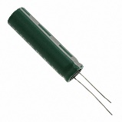
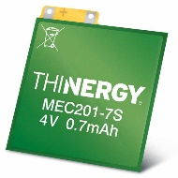
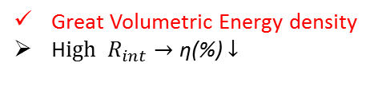
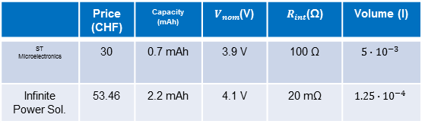
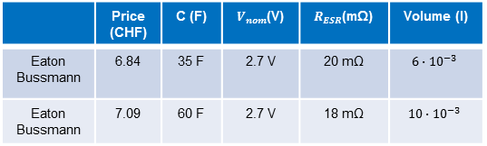
Topology of the Storage System
Ceralink & ELCO
Low Energy Density (~0.3kJ/l)
Large Volume
Expensive
Low $R_{ESR}→$ η(%) $↑$
 | Price (CHF) | C (F) | $V_{nom}$(V) | $R_{ESR}$(mΩ) | Volume (l)
EPCOS (TDK) | 16.00 | 1 μF | 500 V | 12 mΩ | $$3.8∙{10}^{−4}$$
EPCOS (TDK) | 89.00 | 20μF | 500 V | 8 mΩ | $$8.7∙{10}^{−3}$$
 | Price (CHF) | C (F) | $V_{nom}$(V) | $R_{ESR}$(mΩ) | Volume (l)
Nichicon | 268 | 2.2 F | 10 V | 5 mΩ | 2
Vishay | 192.5 | 1 F | 25 V | 5 mΩ | 1.4
 | Price (CHF) | C (F) | $V_{nom}$(V) | $R_{ESR}$(mΩ) | Volume (l)
Eaton Bussmann | 6.84 | 35 F | 2.7 V | 20 mΩ | $$6∙{10}^{−3}$$
Eaton Bussmann | 7.09 | 60 F | 2.7 V | 18 mΩ | $$10∙{10}^{−3}$$
Super Capacitors
Large Energy Density (~15kJ/l)
Cheap
 | Price (CHF) | Capacity (mAh) | $V_{nom}$(V) | $R_{int}$(Ω) | Volume (l)
ST Microelectronics | 30 | 0.7 mAh | 3.9 V | 100 Ω | $$5∙{10}^{−3}$$
Infinite Power Sol. | 53.46 | 2.2 mAh | 4.1 V | 20 mΩ | $$1.25∙{10}^{−4}$$
Thin Film Batterries
Great Volumetric Energy density
H$igh R_{int}→$ η(%) $↓$

Slide 10
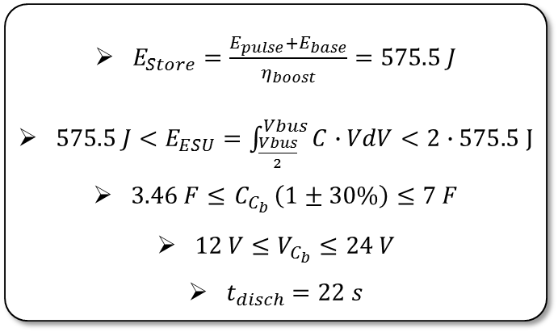
Design of the Storage System
Design
$E_{Store}=\frac{E_{pulse}+E_{base}}{η_{boost}}=575.5 J$
$575.5 J<E_{ESU}=\int_{\frac{Vbus}{2}}^{Vbus}{C∙VdV}<2∙575.5 J$
$3.46 F≤{ C}_{C_{b}}\left(1±30\%\right)≤7 F$
$12 V≤V_{C_{b}}≤24 V$
$t_{disch}=22 s$

Slide 11
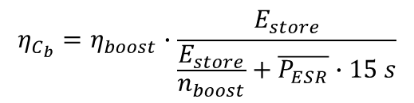
Design of the Storage System
Design
Optimization
$E_{Store}=\frac{E_{pulse}+E_{base}}{η_{boost}}=575.5 J$
$575.5 J<E_{ESU}=\int_{\frac{Vbus}{2}}^{Vbus}{C∙VdV}<2∙575.5 J$
$3.46 F≤{ C}_{C_{b}}\left(1±30\%\right)≤7 F$
$12 V≤V_{C_{b}}≤24 V$
$t_{disch}=22 s$
Cost (CHF)
Volume (l)
Efficiency (%)
$$η_{C_{b}}=η_{boost}∙\frac{E_{store}}{\frac{E_{store}}{n_{boost}}+\overline{P_{ESR}}∙15 s}$$

Slide 12
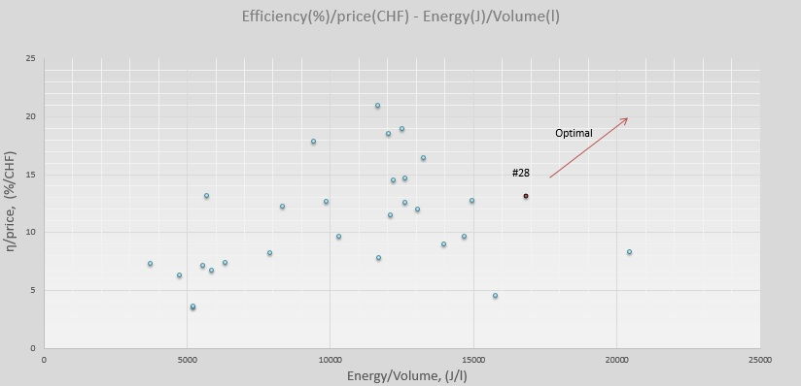
Super Capacitor Optimization

Slide 13

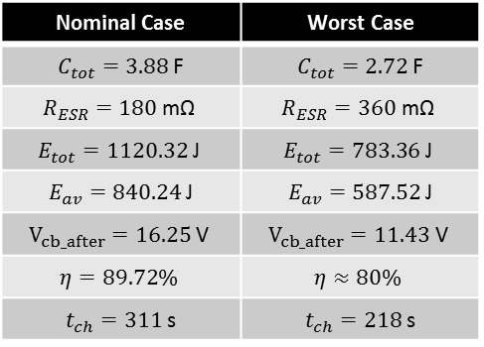
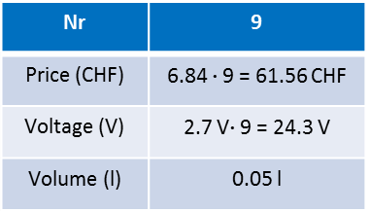
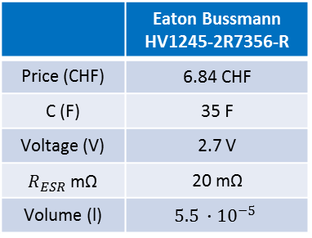
Super Capacitor Optimization
 | Eaton Bussmann HV1245-2R7356-R
Price (CHF) | 6.84 CHF
C (F) | 35 F
Voltage (V) | 2.7 V
$R_{ESR}$ mΩ | 20 mΩ
Volume (l) | $$5.5 ∙{10}^{−5}$$
Nominal Case | Worst Case
$C_{tot}=3.88$ F | $C_{tot}=2.72$ F
$$R_{ESR}=180 \text{m}\text{Ω}$$ | $$R_{ESR}=360 \text{m}\text{Ω}$$
$$E_{tot}=1120.32 \text{J}$$ | $$E_{tot}=783.36 \text{J}$$
$E_{av}=840.24$ J | $E_{av}=587.52$ J
$$V_{cb_after}=16.25 \text{V}$$ | $$V_{cb_after}=11.43 \text{V}$$
$$η=89.72\%$$ | $$η≈80\%$$
$t_{ch}=311$ s | $t_{ch}=218$ s
Nr | 9
Price (CHF) | 6.84 $∙$9 = 61.56 CHF
Voltage (V) | 2.7 V$∙$9 = 24.3 V
Volume (l) | 0.05 l

Slide 14
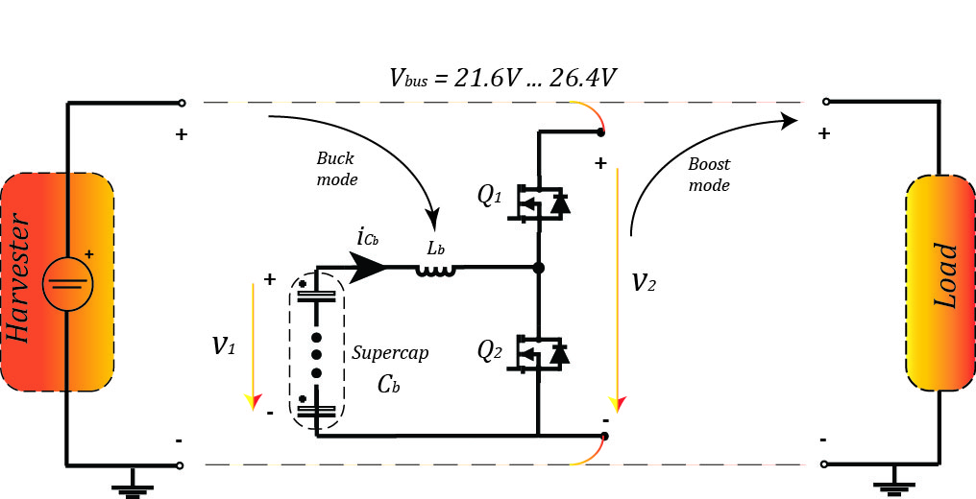
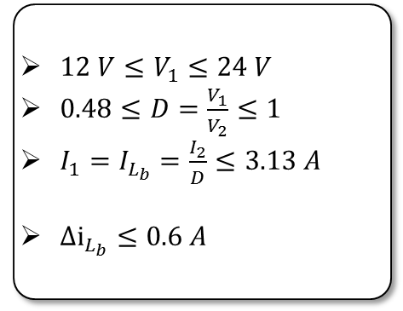
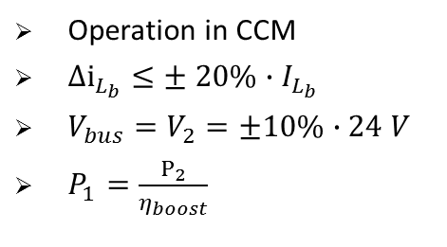
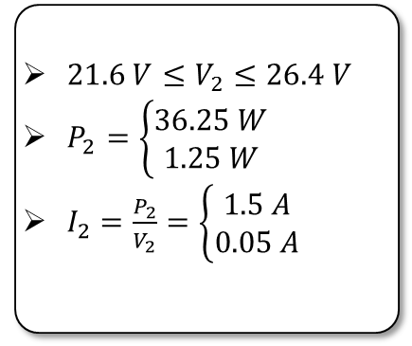
Analysis of the Energy Storage Unit
Requirements
Bus
Storage Unit
$21.6 V≤V_{2}≤26.4 V$
$P_{2}=\left\{\begin{aligned}36.25 W \\ 1.25 W\end{aligned}\right.$
$I_{2}=\frac{P_{2}}{V_{2}}=\left\{\begin{aligned}1.5 A \\ 0.05 A\end{aligned}\right.$
$12 V≤V_{1}≤24 V$
$0.48≤D=\frac{V_{1}}{V_{2}}≤1$
$I_{1}=I_{L_{b}}=\frac{I_{2}}{D}≤3.13 A$
${Δi}_{L_{b}}≤0.6 A$
Operation in CCM
${Δi}_{L_{b}}≤± 20\%∙I_{L_{b}}$
$V_{bus}=V_{2}=±10\%∙24 V$
$P_{1}=\frac{P_{2}}{η_{boost}}$

Slide 15
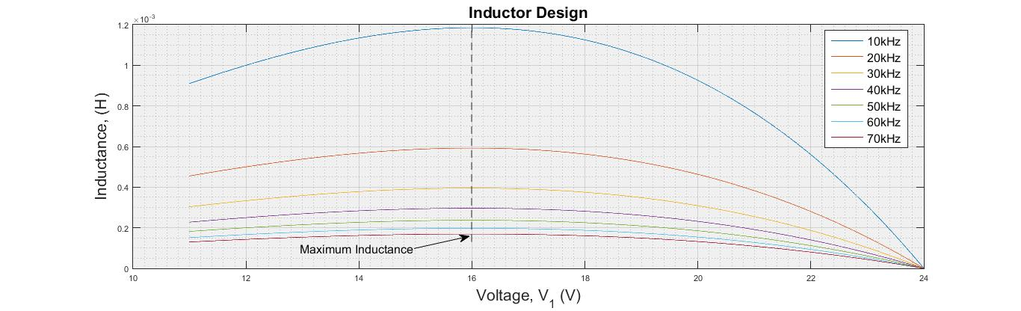
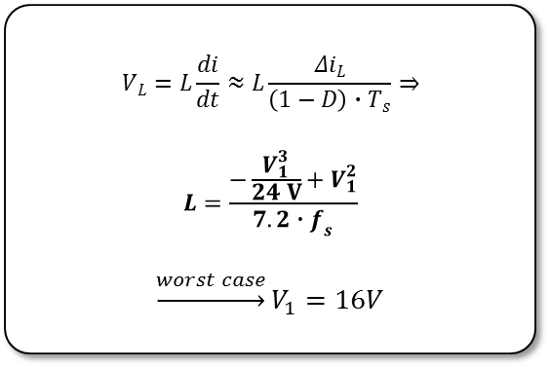
Inductor Optimization (1)
Inductor Design
$$V_{L}=L\frac{di}{dt}≈L\frac{{Δi}_{L}}{\left(1−D\right)∙T_{s}}⇒$$
$$L=\frac{−\frac{V_{1}^{3}}{24 V}+V_{1}^{2}}{7.2∙f_{s}}$$
$$\underset{→}{worst case}V_{1}=16V$$

Slide 16
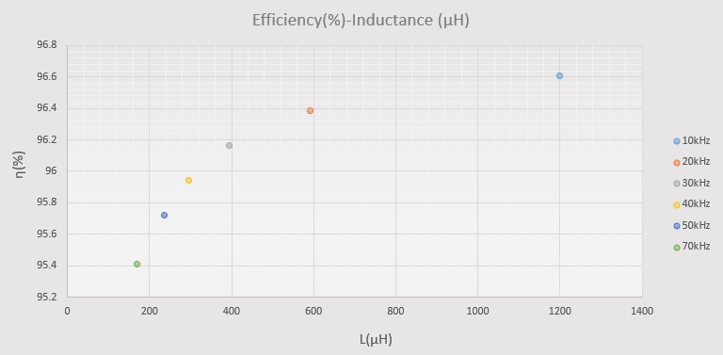
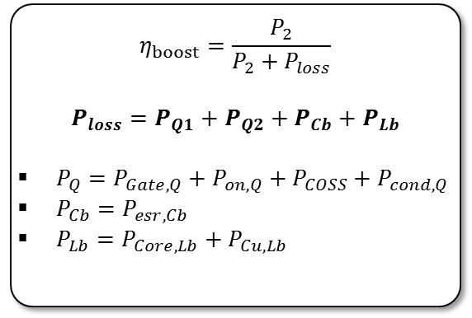
Inductor Optimization (1)
Inductor Design
Efficiency of the ESU
$$V_{L}=L\frac{di}{dt}≈L\frac{{Δi}_{L}}{\left(1−D\right)∙T_{s}}⇒$$
$$L=\frac{−\frac{V_{1}^{3}}{24 V}+V_{1}^{2}}{7.2∙f_{s}}$$
$$\underset{→}{worst case}V_{1}=16V$$
$$η_{boost}=\frac{P_{2}}{P_{2}+P_{loss}}$$
$$P_{loss}=P_{Q1}+P_{Q2}+P_{Cb}+P_{Lb}$$
$P_{Q}=P_{Gate,Q}+P_{on,Q}+P_{COSS}+P_{cond,Q}$
$P_{Cb}=P_{esr,Cb}$
$P_{Lb}=P_{Core,Lb}+P_{Cu,Lb}$

Slide 17
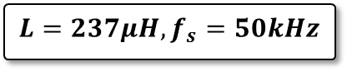
Inductor Optimization (1)
Inductor Design
Efficiency of the ESU
$$V_{L}=L\frac{di}{dt}≈L\frac{{Δi}_{L}}{\left(1−D\right)∙T_{s}}⇒$$
$$L=\frac{−\frac{V_{1}^{3}}{24 V}+V_{1}^{2}}{7.2∙f_{s}}$$
$$\underset{→}{worst case}V_{1}=16V$$
$$η_{boost}=\frac{P_{2}}{P_{2}+P_{loss}}$$
$$P_{loss}=P_{Q1}+P_{Q2}+P_{Cb}+P_{Lb}$$
$P_{Q}=P_{Gate,Q}+P_{on,Q}+P_{COSS}+P_{cond,Q}$
$P_{Cb}=P_{esr,Cb}$
$P_{Lb}=P_{Core,Lb}+P_{Cu,Lb}$
$$L=237μH, f_{s}=50kHz$$

Slide 18
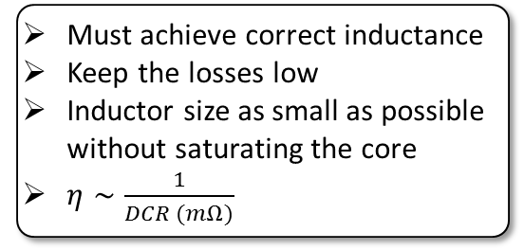
Inductor Optimization (2)
Requirements
Must achieve correct inductance
Keep the losses low
Inductor size as small as possible without saturating the core
$η∼\frac{1}{DCR (mΩ)}$
Commercial Custom cores
GeckoMagnetics simulations
Commercial Fixed value Inductors

Slide 19
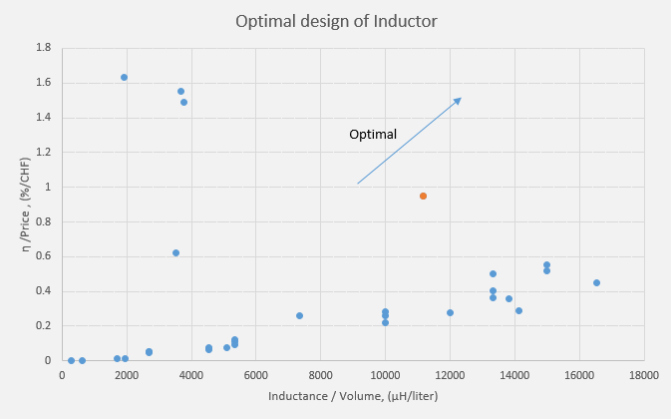
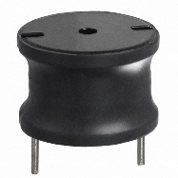
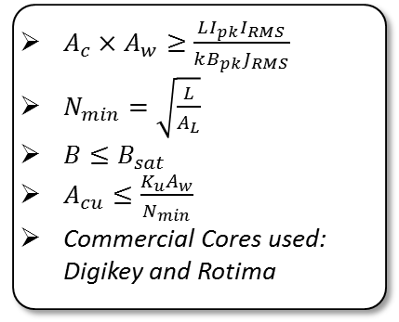
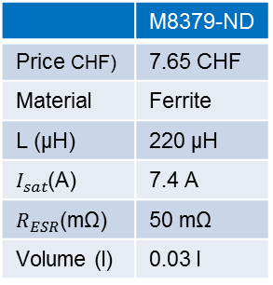
Inductor Optimization (2)
Requirements
Custom Cores
Must achieve correct inductance
Keep the losses low
Inductor size as small as possible without saturating the core
$η∼\frac{1}{DCR (mΩ)}$
Commercial Custom cores
GeckoMagnetics simulations
Commercial Fixed value Inductors
$A_{c}×A_{w}≥\frac{LI_{pk}I_{RMS}}{kB_{pk}J_{RMS}}$
$N_{min}=\sqrt{\frac{L}{A_{L}}}$
$B≤B_{sat}$
$A_{cu}≤\frac{K_{u}A_{w}}{N_{min}}$
Commercial Cores used: Digikey and Rotima
GeckoMagnetics
Selected Inductor
RM 14 0.15mm | ETD 54/28/19
290 μΗ | 294.59 μΗ
N87+ | N87+
AWG12 | AWG12
15 turns | 14 turns
9.2 mΩ | 9.4 mΩ
0.08 l | 0.04 l
7 CHF | 11.2 CHF
 | M8379-ND
Price CHF) | 7.65 CHF
Material | Ferrite
L (μH) | 220 μH
$I_{sat}$(A) | 7.4 A
$R_{ESR}$(mΩ) | 50 mΩ
Volume (l) | 0.03 l

Slide 20
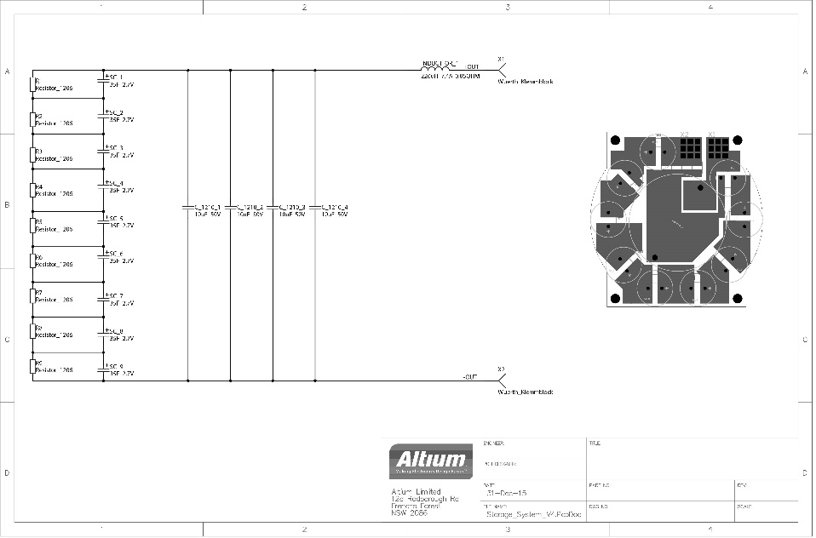
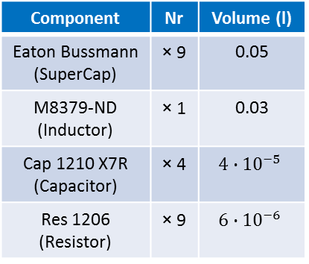
Hardware Implementation
Component | Nr | Volume (l)
Eaton Bussmann (SuperCap) | × 9 | 0.05
M8379-ND (Inductor) | × 1 | 0.03
Cap 1210 X7R (Capacitor) | × 4 | $$4∙{10}^{−5}$$
Res 1206 (Resistor) | × 9 | $$6∙{10}^{−6}$$

Slide 21
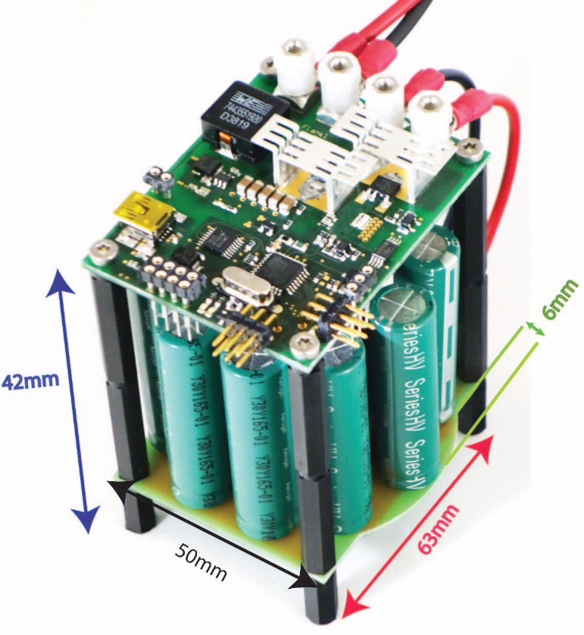
Hardware Implementation
Volume
0.18 liter
Component | Nr | Volume (l)
Eaton Bussmann (SuperCap) | × 9 | 0.05
M8379-ND (Inductor) | × 1 | 0.03
Cap 1210 X7R (Capacitor) | × 4 | $$4∙{10}^{−5}$$
Res 1206 (Resistor) | × 9 | $$6∙{10}^{−6}$$

Slide 22
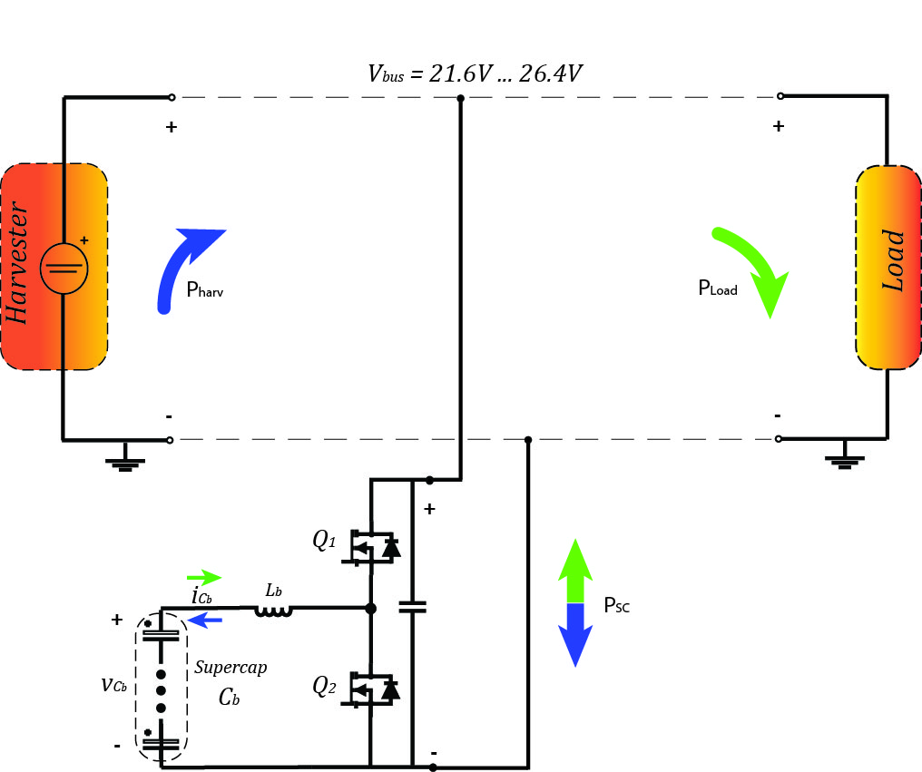
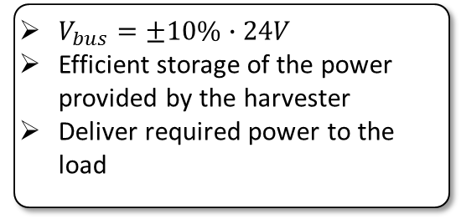
Control Scheme
Requirements
$V_{bus}=±10\%∙24V$
Efficient storage of the power provided by the harvester
Deliver required power to the load
Notes:
build a circuit that automatically adjusts the duty cycle as necessary, to obtain the specified output voltage with high accuracy, regardless of disturbances or component tolerances.

Slide 23
Control Scheme
Requirements
$V_{bus}=±10\%∙24V$
Efficient storage of the power provided by the harvester
Deliver required power to the load
Solution
Use of a closed-loop control scheme (negative feedback)
Adjust duty cycle to obtain desired output voltage regardless Load variations and Storage Unit voltage
Notes:
build a circuit that automatically adjusts the duty cycle as necessary, to obtain the specified output voltage with high accuracy, regardless of disturbances or component tolerances.

Slide 24
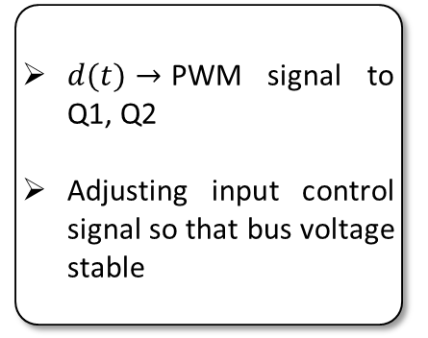
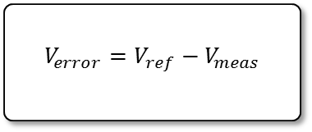
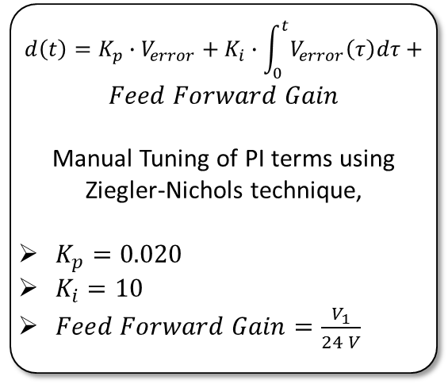
PI Control
PI Control
Reduces steady-state error
Improve the rejection of low frequency disturbances
Special attention must be given to the stability of the system
PI Controller
$$d\left(t\right)=K_{p}∙V_{error}+K_{i}∙\int_{0}^{t}{V_{error}\left(τ\right)dτ}+$$
$$Feed Forward Gain$$
Manual Tuning of PI terms using Ziegler-Nichols technique,
$K_{p}=0.020$
$K_{i}=10$
$Feed Forward Gain=\frac{V_{1}}{24 V}$
Converter
$d(t)→$PWM signal to Q1, Q2
Adjusting input control signal so that bus voltage stable
Input
$$V_{error}=V_{ref}−V_{meas}$$
Notes:
- PI control attempts to drive the error to zero (Vref=Vout)
- It is performed by setting the I (integral) gains to zero and increase the Kp gain until it reaches the value Ku, at which the output of the control loop has stable and consistent oscillations. Ku and the oscillation period Tu are used to set the P and I gains

Slide 25
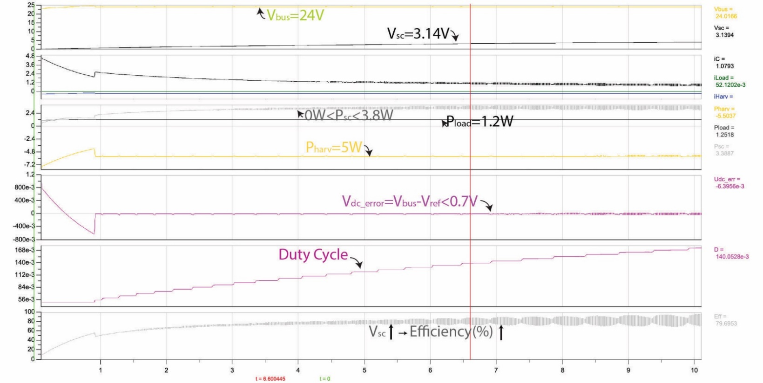
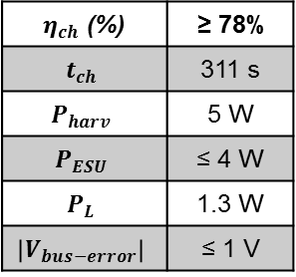

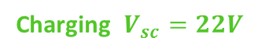
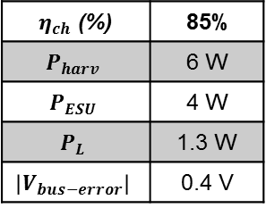

PI Control Simulations – Charging Stage
Charging $V_{sc}=0V$
Charging $V_{sc}=22V$
Summary
$η_{ch}$ (%) | ≥ 78%
$$t_{ch}$$ | 311 s
$$P_{harv}$$ | 5 W
$$P_{ESU}$$ | ≤ 4 W
$$P_{L}$$ | 1.3 W
$$\left|V_{bus−error}\right|$$ | ≤ 1 V
$η_{ch}$ (%) | 78%
$$P_{harv}$$ | 5.5 W
$$P_{ESU}$$ | 3 W
$$P_{L}$$ | 1.25 W
$$\left|V_{bus−error}\right|$$ | 0.7 V
$η_{ch}$ (%) | 85%
$$P_{harv}$$ | 6 W
$$P_{ESU}$$ | 4 W
$$P_{L}$$ | 1.3 W
$$\left|V_{bus−error}\right|$$ | 0.4 V
Notes:
The harvester may be simulated as a constant voltage source of 26.4V output and 11.43 internal
resistance.
As was explained in the rst chapter, the storage unit in order to be fully charged needs
approximately 300 seconds which is not possible to be simulated. Thus two gures are displayed;
the rst one is from the rst 10 seconds and at the second one Vsc was initialized at 22V.
So, in
the beginning a large amount of power is consumed in the internal ESR of each cell but as the
voltage across it continues to increase, it is used for the charging of the storage unit.
Finally, it is noted that the optimum way to charge the Supercapacitors is by providing maximum
power transfer from the harvester to the ESU. This may happen by applying almost constant
current with an exponential increasing voltage until it reaches 24V point at which the current is
falling to keep the absorbed power constant.

Slide 26





PI Control Simulations – Discharging Stage
Discharging $0≤t≤10s$
Discharging t=1s
Summary
$η_{disch}$ (%) | 95%
$$V_{bus−max}$$ | 26.4 V
$$\left|V_{bus−error}\right|$$ | 2.4 V
$$V_{bus}−t_{rise}$$ | 300μs
$$V_{bus}−t_{oscill}$$ | 2.3 ms
$η_{disch}$ (%) | 95%
$$t_{disch}$$ | 22 s
$$P_{ESU}$$ | ≤ 38 W
$$P_{L}$$ | ≤ 36.5 W
$$\left|V_{bus−error}\right|$$ | ≤ 2.4 V
$η_{disch}$ (%) | 95 %
$$P_{ESU}$$ | 38 W
$$P_{L}$$ | 36.2 W
$$\left|V_{bus−error}\right|$$ | ≤ 2.4 V
Notes:
The harvester may be simulated as a constant voltage source of 26.4V output and 11.43 internal
resistance.
As was explained in the rst chapter, the storage unit in order to be fully charged needs
approximately 300 seconds which is not possible to be simulated. Thus two gures are displayed;
the rst one is from the rst 10 seconds and at the second one Vsc was initialized at 22V.
So, in
the beginning a large amount of power is consumed in the internal ESR of each cell but as the
voltage across it continues to increase, it is used for the charging of the storage unit.
Finally, it is noted that the optimum way to charge the Supercapacitors is by providing maximum
power transfer from the harvester to the ESU. This may happen by applying almost constant
current with an exponential increasing voltage until it reaches 24V point at which the current is
falling to keep the absorbed power constant.

Slide 27


Software Implementation
Characteristics
Used μC: ATMEGA88PA
Sampling period = 4kHz
Reading of the ADC values = 128 kHz
$K_{p}=0.020\frac{digits}{Volt}$
$K_{i}=0.0025\frac{digits}{Volt}$
Limitations
Integral windup ($K_{i}$ term accumulates a significant error)
$⟹$If it reaches a max value $→$ re-initialize
ADC inputs read large spikes
$⟹$Keep the last values and average them
Float numbers result in slow running times
$⟹$Use of integer numbers
Fast PWM signal of 64 kHz

Slide 28





Experimental Results
$$V_{harv}$$ | 25.4 V
$$I_{harv}$$ | 0.2 A
$$V_{sc}$$ | 1.8V $∙$ 9 = 16.2 V
$$I_{sc}$$ | 0.185 A
$$\left|V_{bus−error}\right|$$ | < 1 V
Experimental
Re-tuning of PI terms
Keep bus voltage stable
$$V_{bus}=±10\%∙24V$$
Charging Efficiency,
$$η_{ch}=75\%$$
$$η_{ch−exp}$$ | 75%
Simulations
$$η_{ch−sim}$$ | 78%

Slide 29

Conclusions
Summary
Optimum Storage System and inductor design and implementation in terms of cost (CHF), Volume (l) and Efficiency (%) was designed
PI controller achieved to keep $V_{bus}$ stable regardless load and voltage variations
Verified by simulations (GeckoCircuits) and experiments

Slide 30

Outlook
Future work
Experimental setup for the discharging cycle
Improved PI control scheme
Cascaded voltage and current loop control
Improved Evaluation of PI terms by using different values for
$V_{store}≤12V$ and $V_{store}≥12V$
Optimization of algorithm for integer numbers

Slide 31
Discussion

Slide 32



Super Capacitors
Balancing SuperCapacitors
$$τ={C_{b1}∙R}_{balance}$$
$$P_{losses}=\frac{{(24V)}^{2}}{9∙R_{balance}}≤0.5 W$$
Impact on generator
$$P_{store}≈\frac{1}{η_{boost}}∙\frac{E_{Cb_max}}{t_{ch}}$$

Slide 33







Inductor Design
1. Sizing a toroidal Core
$\left.\begin{aligned}A_{c}=h\frac{(d_{o}−d_{i})}{2} \\ A_{w}=d_{i}^{2}\frac{π}{4} \end{aligned}\right\}$ $A_{c}×A_{w}≥\frac{LI_{pk}I_{RMS}}{kB_{pk}J_{RMS}}$
2. Check $B_{sat}$
$$B=\frac{LI_{pk}}{NA_{c}}$$
$$l_{g}=\frac{μ_{ο}LI_{pk,Lb}^{2}}{B_{max}^{2}A_{c}}$$
In case of exceed of $B_{sat}$
Choose larger/different Core/Material
Operate in lower current
Increase air gap
Increase number of turns
3. Number of Turns
5. Define Power losses
$$P_{Lb}=P_{Core,Lb}+P_{Cu,Lb}$$
$$P_{core}=\left\{\begin{aligned}P_{V}∙V_{e} \\ Steinmetz equations\end{aligned}\right.$$
$$P_{Cu,Lb}=r_{Lb}∙I_{Lb,RMS}^{2}$$
$$r_{Lb}=ρ∙\frac{N∙MLT}{A}$$
$$N=\frac{LI_{pk}}{B_{pk}A_{c}}$$
$$L=A_{L}N^{2}$$
4. Winding type
$$A_{cu}≤\frac{K_{u}A_{w}}{N_{min}}$$

Slide 34



Inductor Results
Ferrite Cores
Rotima Cores
$A_{c}∙A_{w}≥0.5 {cm}^{4}$
$B_{sat}≤0.3 T$
$N_{min}=\sqrt{\frac{L}{A_{L}}}$
$A_{c}∙A_{w}≥0.05 {cm}^{4}$
$B_{sat}≤1.56 T$
$N_{min}=\sqrt{\frac{L}{A_{L}}}$
Price (CHF) | O.D. (mm) | V (cm³) | A_{c} x A_{w} (cm⁴) | N_{min} | B (T) | $l_{g}$(mm)
8.61 | 51.80 | 45 | 13.83 | 8.2 | 0.65 | 2.07
15.13 | 65.30 | 89 | 34.69 | 4.9 | 0.70 | 1.33
3.26 | 31.00 | 12 | 2.18 | 4.8 | 2.84 | 5.28
3.37 | 35.50 | 13 | 2.72 | 7.4 | 1.71 | 4.93
3.82 | 37.50 | 18 | 3.98 | 4.7 | 2.33 | 4.24
11.66 | 60.10 | 53 | 19.92 | 7.5 | 0.92 | 2.67
3.47 | 37.50 | 18 | 3.98 | 6.1 | 1.80 | 4.24
10.64 | 58.30 | 47 | 19.92 | 7.5 | 0.92 | 2.67
 | O.D. (mm) | V (cm³) | A_{c} x A_{w} (cm⁴) | N_{min} | B (T)
MP1603MP | 15.79 | 0.345 | 0.055 | 104.7 | 1.11
MP1710MP | 17.47 | 0.938 | 0.23 | 75.6 | 0.69
MP2010MP | 19.93 | 1.538 | 0.348 | 63.9 | 0.54
MP2310MP | 22.96 | 2.382 | 0.494 | 56.1 | 0.44
MP2510MP | 25.55 | 1.888 | 0.725 | 78.8 | 0.49
MP3310MP | 32.43 | 5.336 | 1.21 | 50.1 | 0.30
MP3510MP | 34.92 | 5.577 | 1.77 | 55.5 | 0.29

Slide 35



Mosfet Losses
Mosfet losses
Gate Losses | $$P_{Gate,Q1}=Q_{G}∙ΔV_{G}∙f_{s}$$ $$P_{Gate,Q2}=Q_{G}∙ΔV_{G}∙f_{s}$$
Turn-on Losses | $$P_{on,Q1}≈0$$ $$P_{on,Q2}=\frac{V_{Q2}∙I_{Q2}}{2}∙t_{on} ∙f_{s}+Q_{rr}∙V_{Q2}$$
Turn-off Losses | $$P_{off,Q1}≈0$$ $$P_{off,Q2}≈0$$
C_{oss} Losses | $$P_{Coss}=\frac{C_{oss}∙V_{o}^{2}}{2}∙f_{s}$$
Conduction Losses | $$P_{Cond,Q1}=I_{RMS,Q1}^{2}∙r_{DS}={\left(\frac{I_{o}}{\sqrt{D}}\right)}^{2}∙r_{DS}$$ $$P_{Cond,Q2}=I_{RMS,Q2}^{2}∙r_{DS}={\left(\frac{I_{o}\sqrt{1−D}}{D}\right)}^{2}∙r_{DS}$$
$$η_{boost}=\frac{P_{2}}{P_{2}+P_{loss}}$$
$$P_{loss}=P_{Q1}+P_{Q2}+P_{Cb}+P_{Lb}$$
$P_{Q}=P_{Gate,Q}+P_{on,Q}+P_{COSS}+P_{cond,Q}$
$P_{Cb}=P_{esr,Cb}$
$P_{Lb}=P_{Core,Lb}+P_{Cu,Lb}$

Slide 36


Discharging Stage at t=1s
Discharging t=1s
$$V_{bus−max}$$ | 26.4 V
η (%) | 95%
$$\left|V_{bus−error}\right|$$ | 2.4 V
$$V_{bus}−t_{rise}$$ | 300μs
$$V_{bus}−t_{oscill}$$ | 2.3 ms

Slide 37

ADC Reading Problem

